Slide 1

INTRODUCTION TO PYTHON

Slide 2
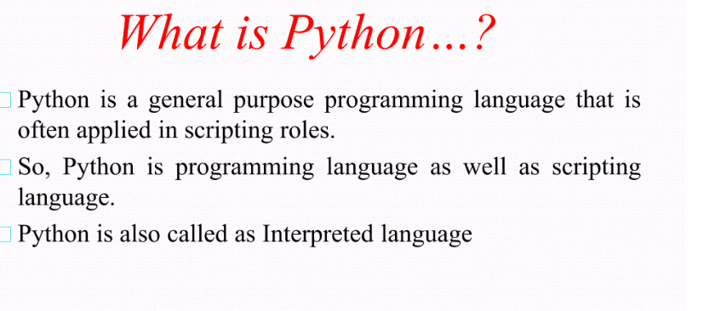

Slide 3
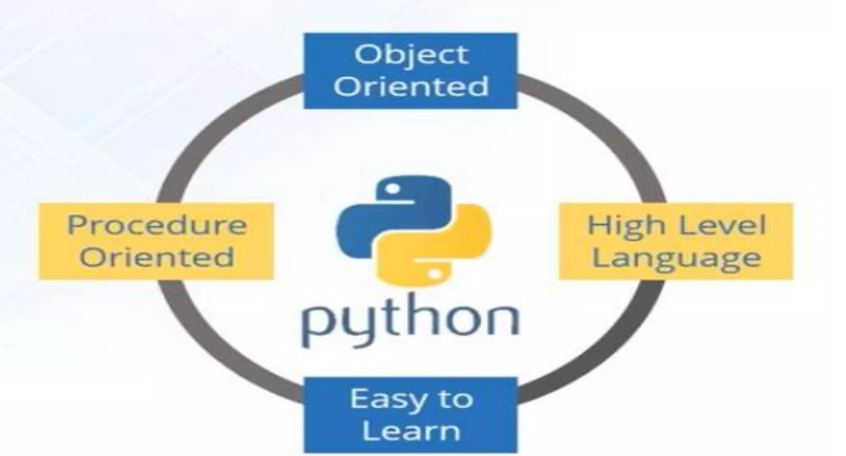

Slide 4
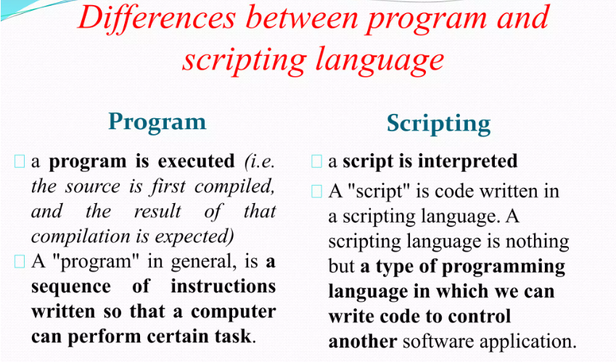

Slide 5
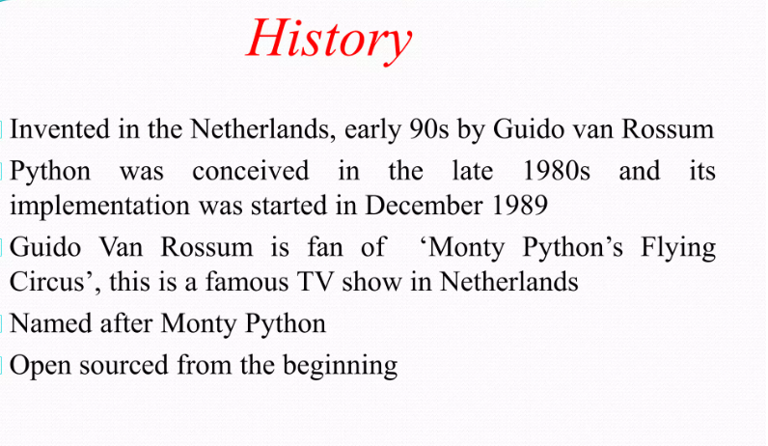

Slide 6
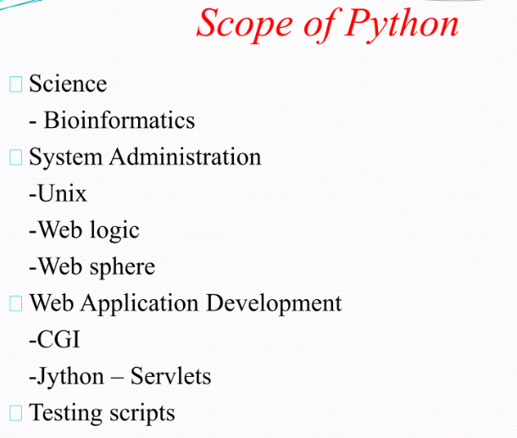

Slide 7
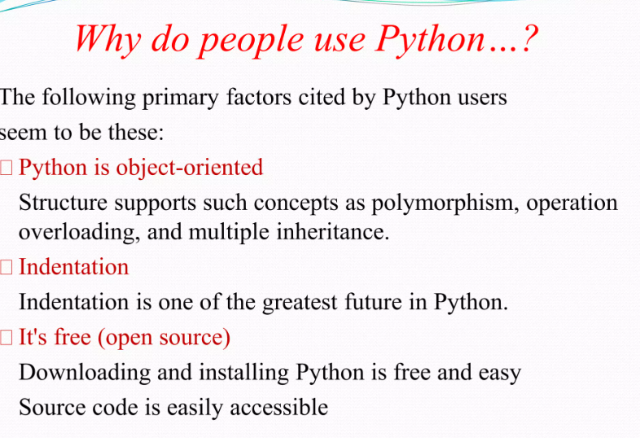

Slide 8
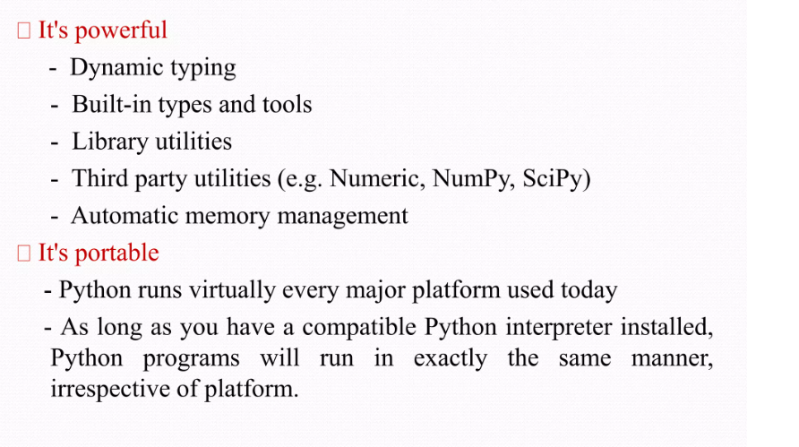

Slide 9
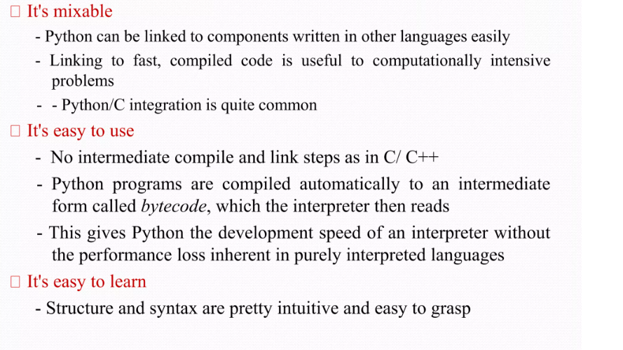

Slide 10
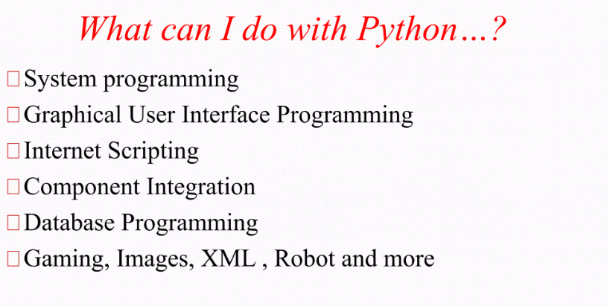

Slide 11
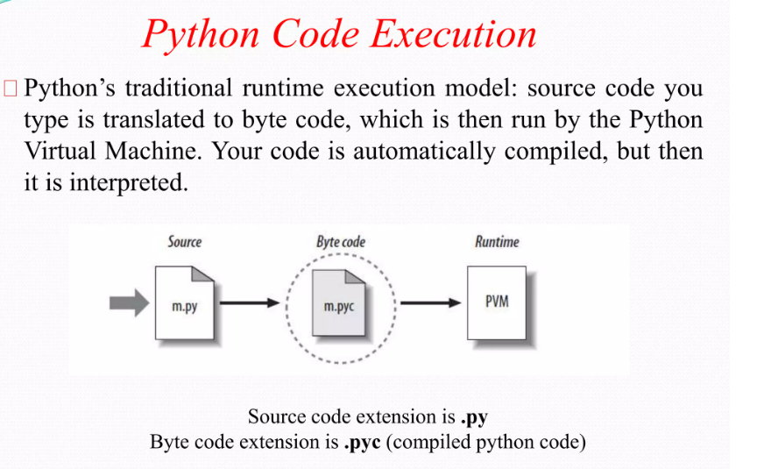

Slide 12
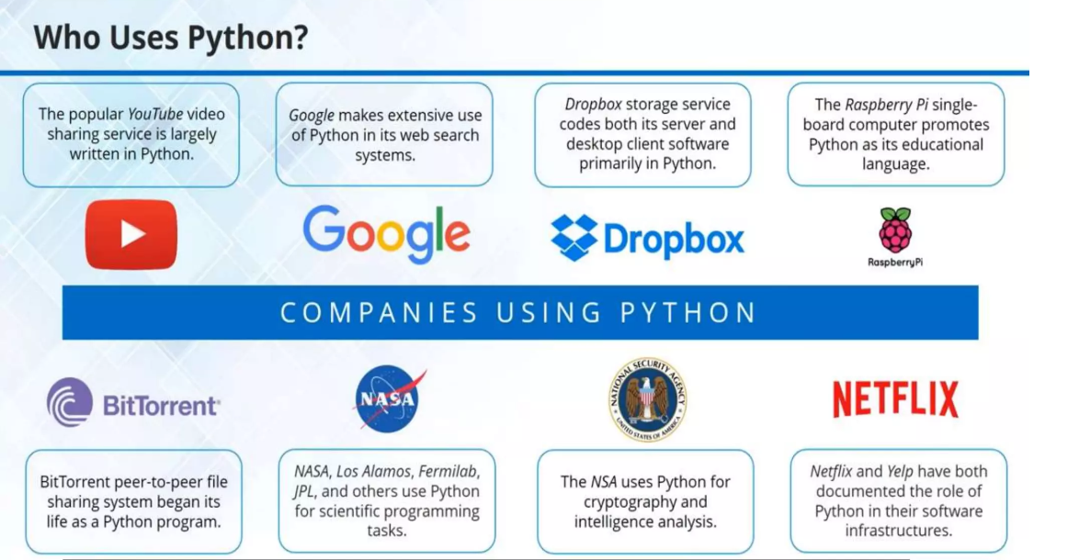

Slide 13
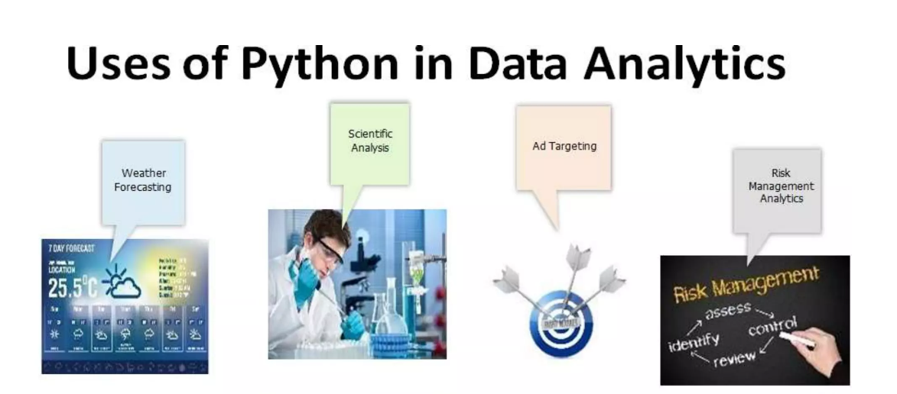

Slide 14
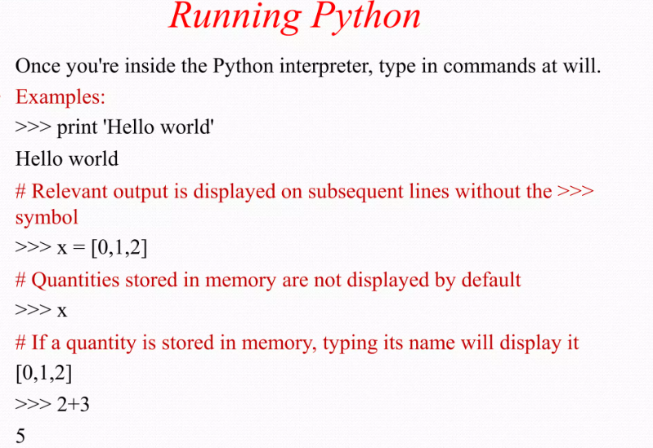

Slide 15
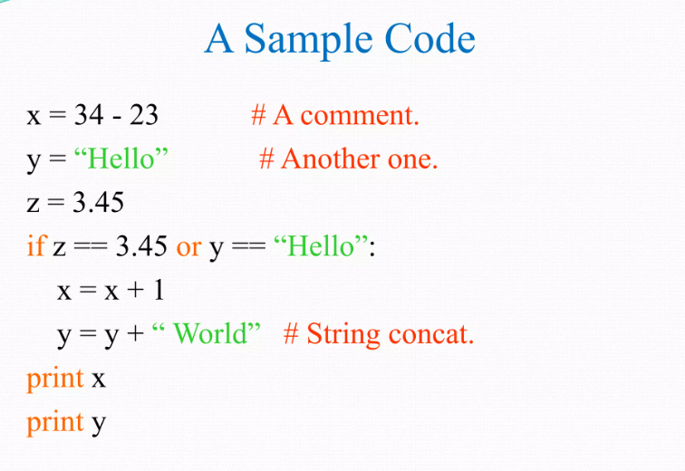

Slide 16
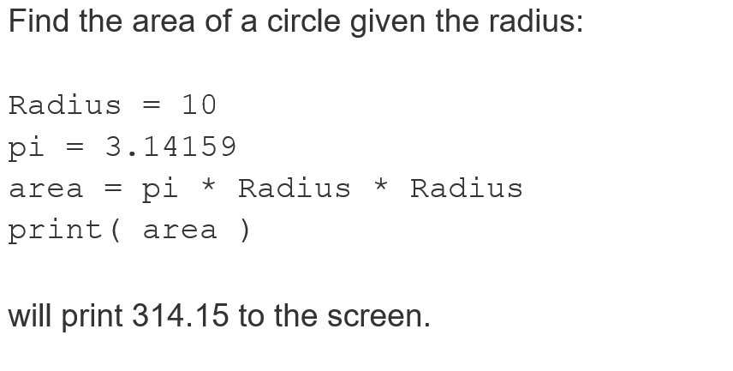

Slide 17
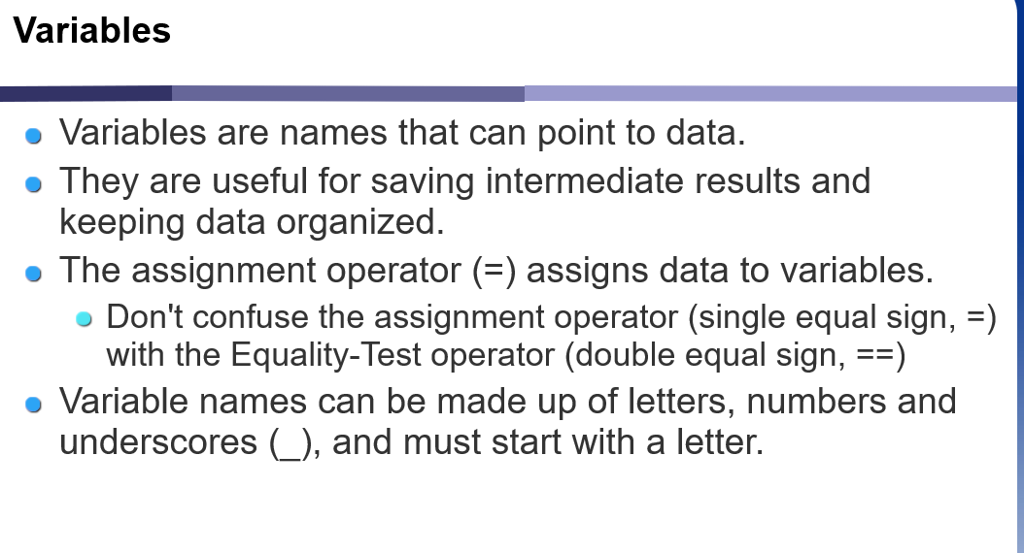
VARIABLES

Slide 18
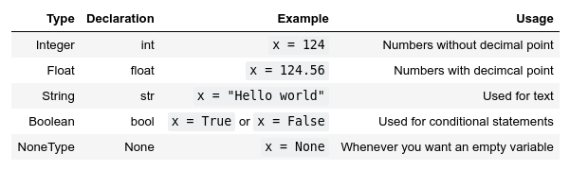
Variables and its type
Variables actually have a type, which defines the way it is stored.
The basic types are:

Slide 19
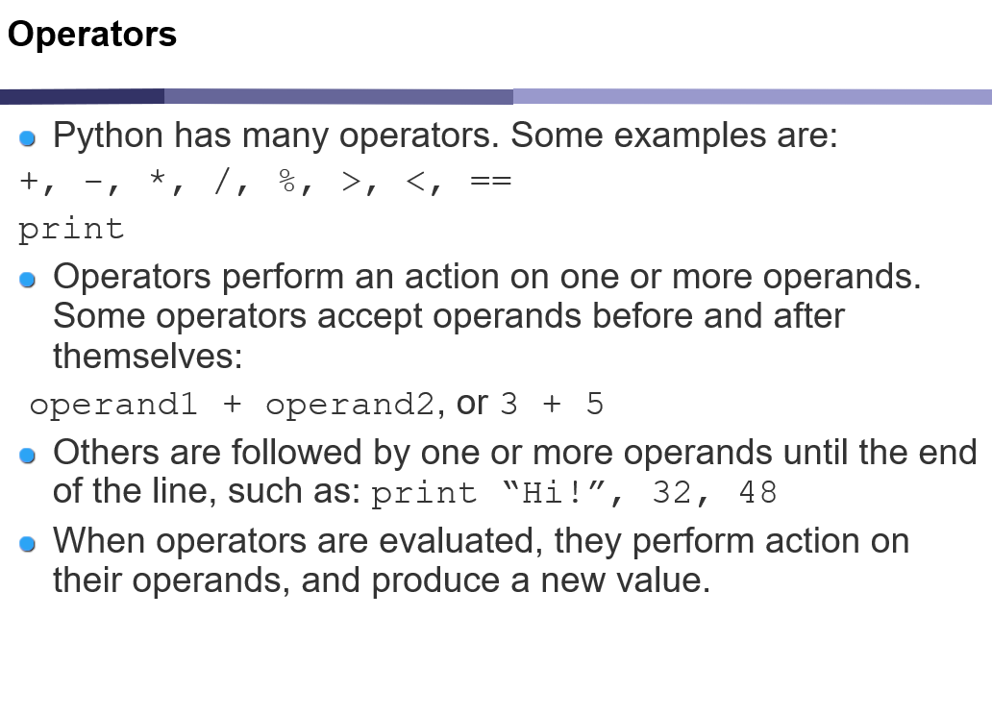
Operators

Slide 20
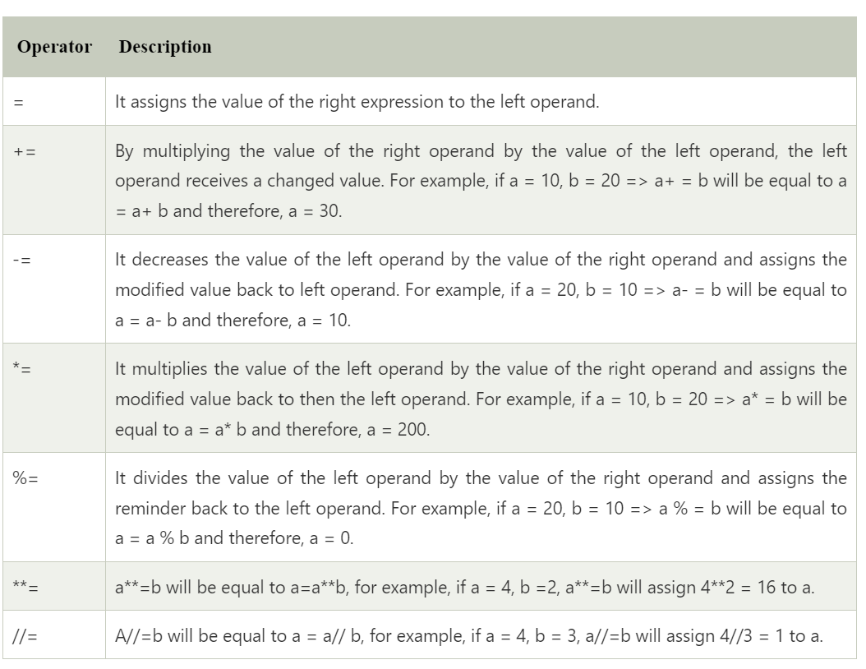
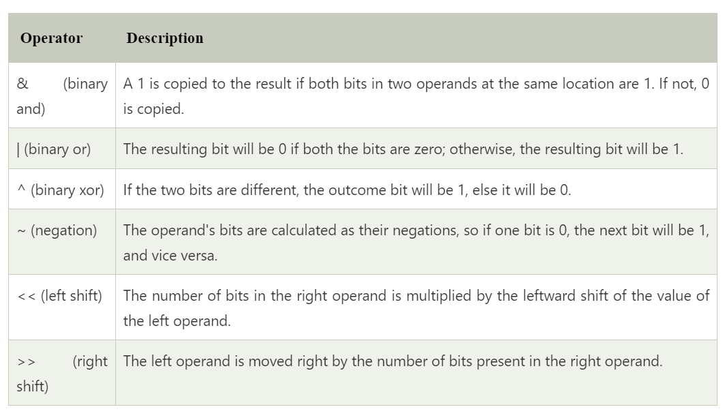
Assignment & Bitwise operator

Slide 21
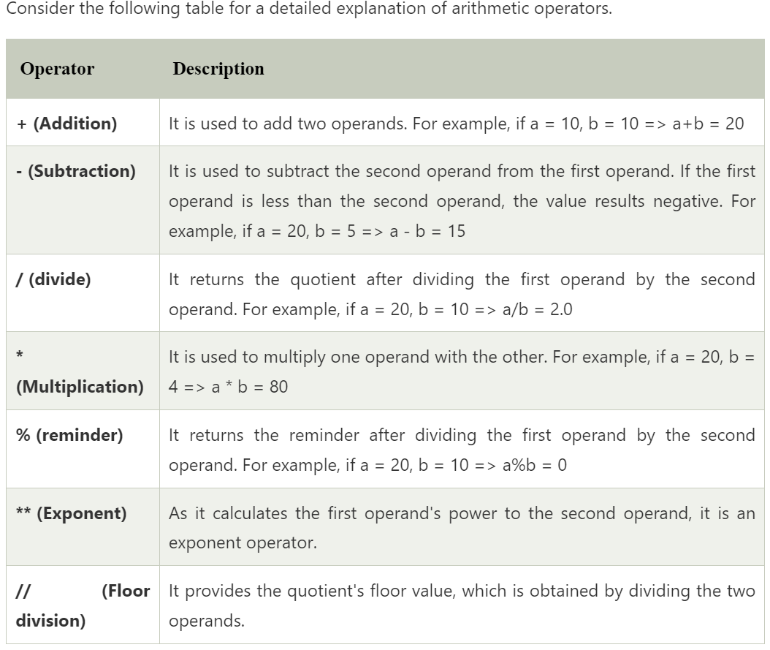
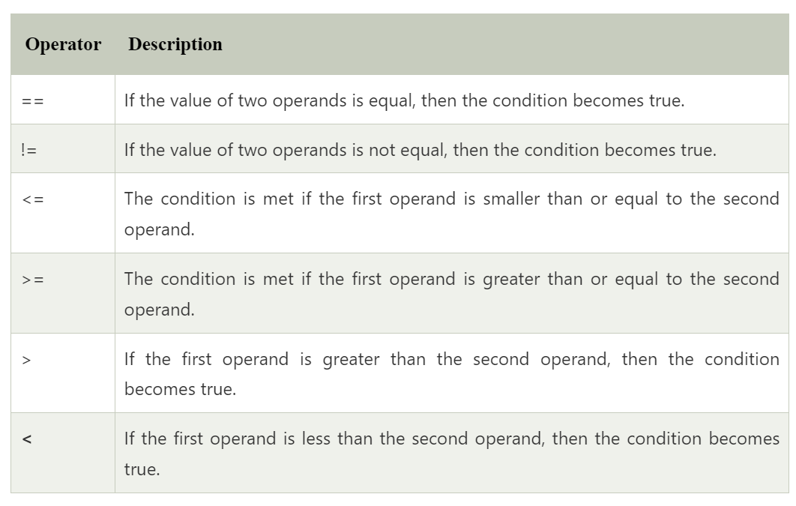
Arithmetic & comparison operator

Slide 22
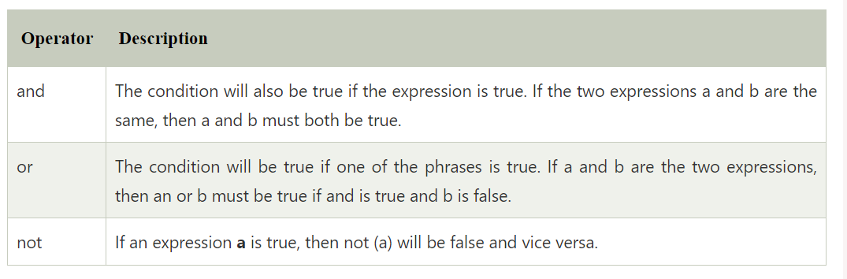
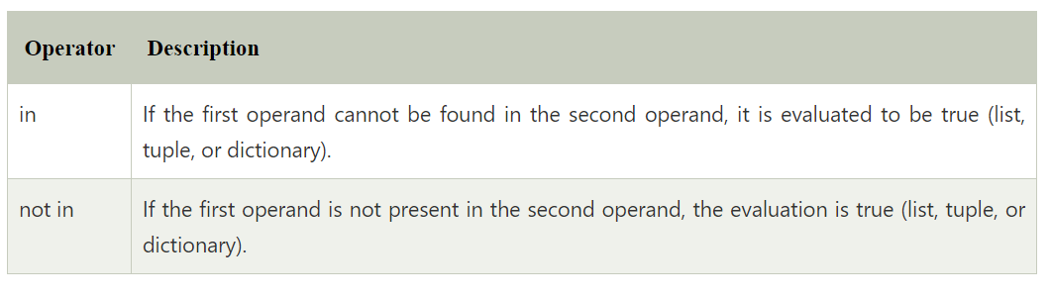
Logical & membership operator

Slide 23
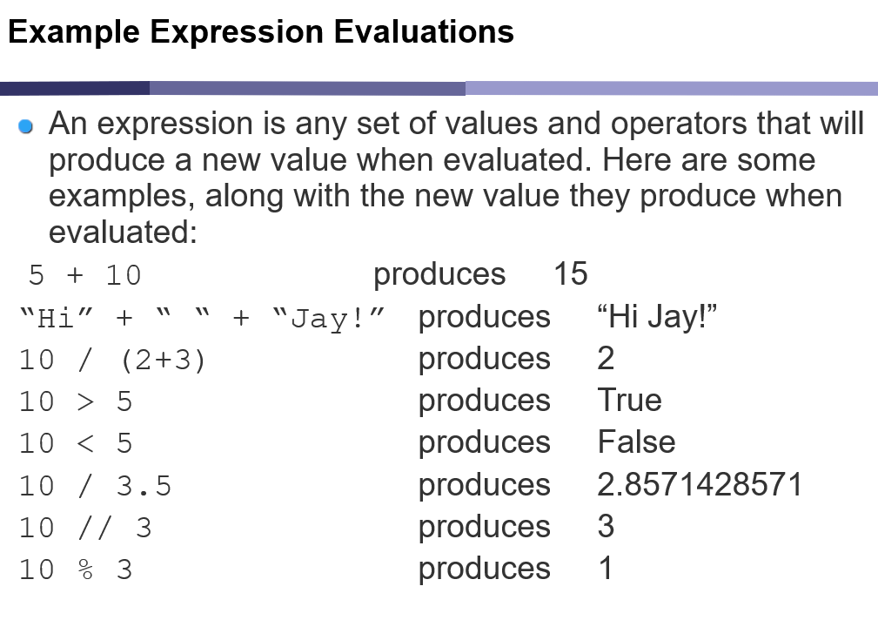
Expression

Slide 24
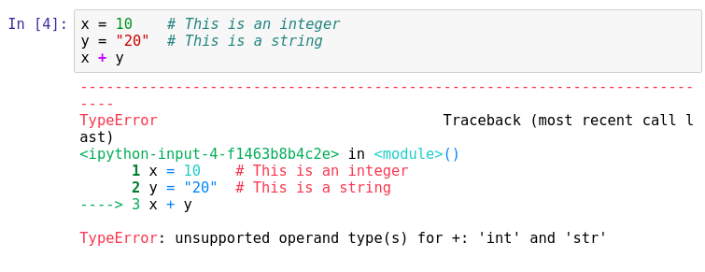
Error

Slide 25
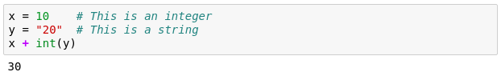
Type casting

Slide 26
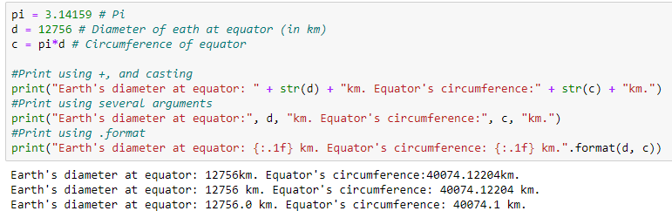
Print statement

Slide 27
Comments

Slide 28
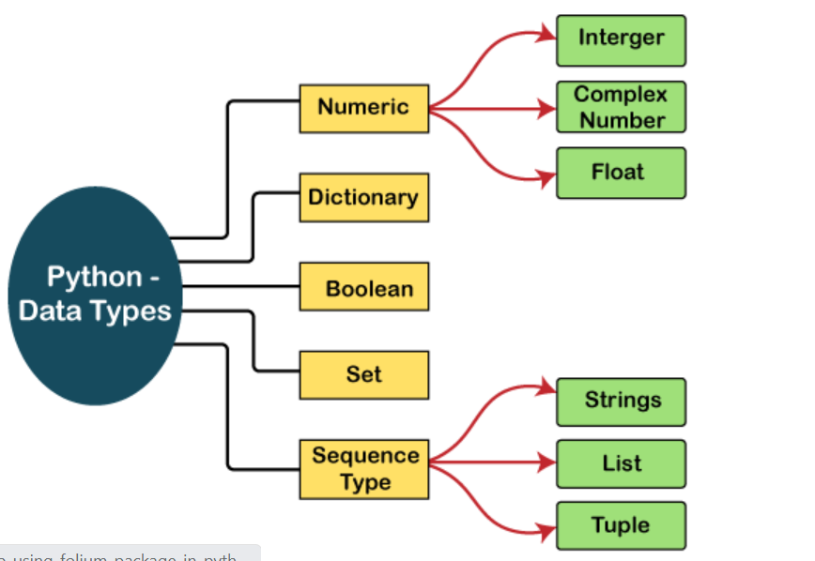
PYTHON DATA TYPES

Slide 29
Numeric
Int - Integer value can be any length such as integers 10, 2, 29, -20, -150 etc. Python has no restriction on the length of an integer. Its value belongs to int
Float - Float is used to store floating-point numbers like 1.9, 9.902, 15.2, etc. It is accurate upto 15 decimal points.
complex - A complex number contains an ordered pair, i.e., x + iy where x and y denote the real and imaginary parts, respectively. The complex numbers like 2.14j, 2.0 + 2.3j, etc.

Slide 30
Sequence Type String
1 .STRING:The string can be defined as the sequence of characters represented in the quotation marks. ex. Say= “hello”
"hello"+" python" returns "hello python".
"Python" *2 returns 'Python Python'.

Slide 31
Example
str1 = 'hello Interns’ #string str1
str2 = 'how are you’ #string str2
print (str1[0:2]) #printing first two character using slice operator
print (str1[4]) #printing 4th character of the string
print (str1*2) #printing the string twice
print (str1 + str2) #printing the concatenation of str1 and str2

Slide 32
String functions
Count
Endswith
Find
Isalnum
Isalpha
Isdigit
Islower
Isspace
Istitle
Isupper
Join
Lower
upper
Replace
Split
Splitlines
Startswith
endswith

Slide 33
Example
# count the entire string for ‘s’
‘This is a string’.count(‘s’)
=> 3
# FIND from index 4 to end of string
‘This is a string’.find(‘s’, 4)
=> 6

Slide 34
Personal Branding Session
Update your LinkedIn Profile
Catching headline
Include achievements
Include Certificates
Update your personal experience
Share DS related content, article recent in market
Follow DS and AI companies including me Tanishq and Oeson
Connect with peers
Make a video of your project explaining the project.
Post it on LinkedIn Providing #tag like #Oeson #Tanishq #Minakshi Gautam
Comment and praise each one's work to get engagements.
Most important create a GitHub profile upload your projects and include a link on your
Shared video(Mandatory)

Slide 35
LIST
2.List
Python Lists are similar to arrays in C. However, the list can contain data of different types. The items stored in the list are separated with a comma (,) and enclosed within square brackets [].
We can use slice [:] operators to access the data of the list. The concatenation operator (+) and repetition operator (*) works with the list in the same way as they were working with the strings.
The index starts with 0.

Slide 36
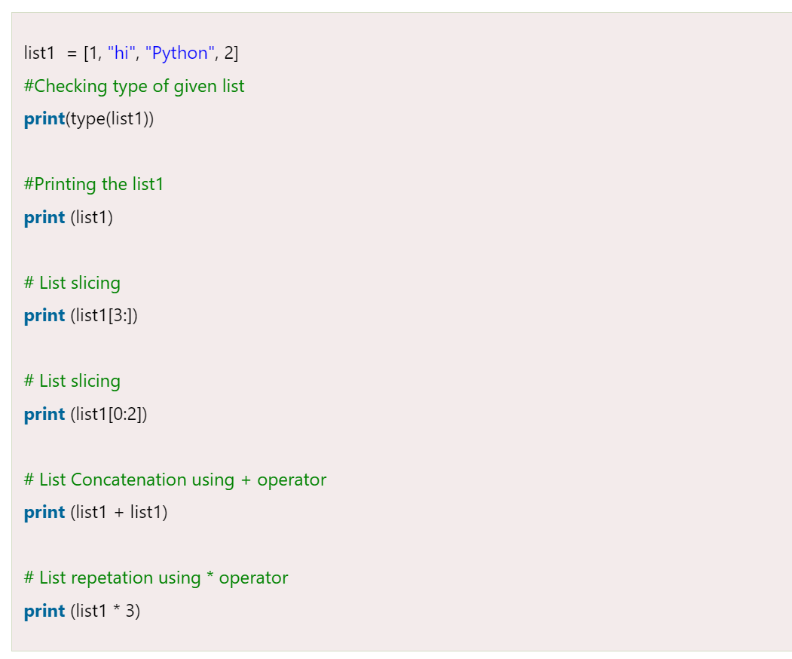
TRY these examples

Slide 37
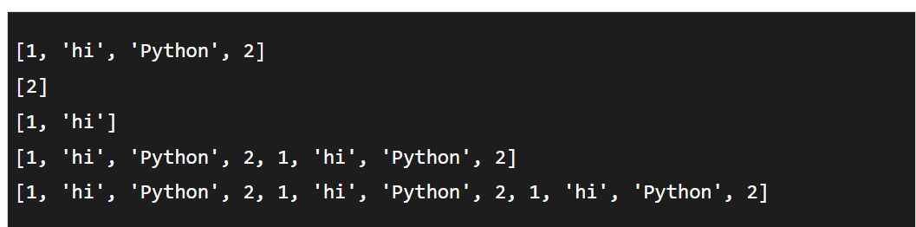
output

Slide 38
List operations
Accessing Values in Lists
list1 = ['physics', 'chemistry', 1997, 2000];
list2 = [1, 2, 3, 4, 5, 6, 7 ];
Print( "list1[0]: ", list1[0])
Print( "list2[1:5]: ", list2[1:5])
Updating Lists
list = ['physics', 'chemistry', 1997, 2000];
Print( "Value available at index 2 : “)
print l(list[2])
list[2] = 2001;
Print( "New value available at index 2 : “)
print (list[2])

Slide 39
Delete List Elements
list1 = ['physics', 'chemistry', 1997, 2000];
print list1
del list1[2]
Print( "After deleting value at index 2 : “)
print (list1)

Slide 40
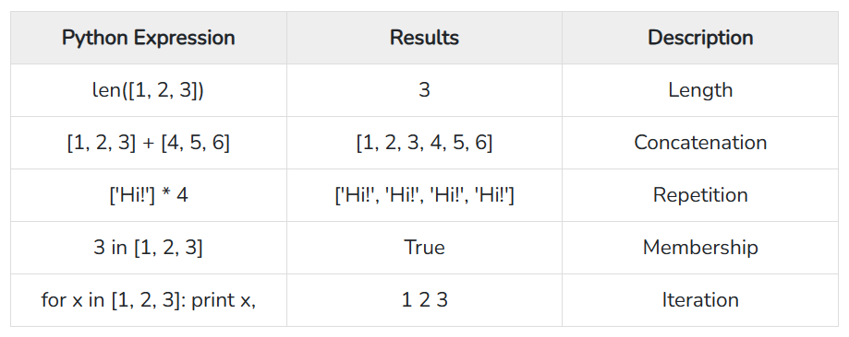

Slide 41
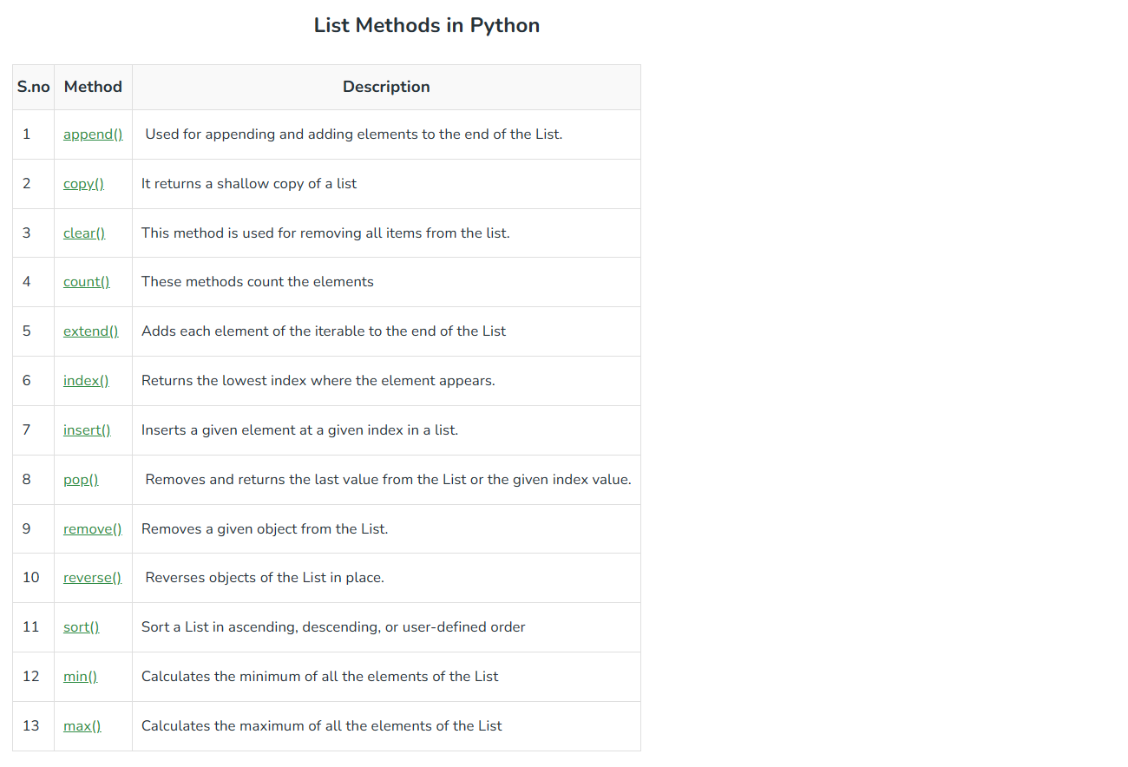
LIST METHODS

Slide 42
Tuple
A tuple is similar to the list in many ways. Like lists, tuples also contain the collection of the items of different data types. The items of the tuple are separated with a comma (,) and enclosed in parentheses ().
A tuple is a read-only data structure as we can't modify the size and value of the items of a tuple.

Slide 43
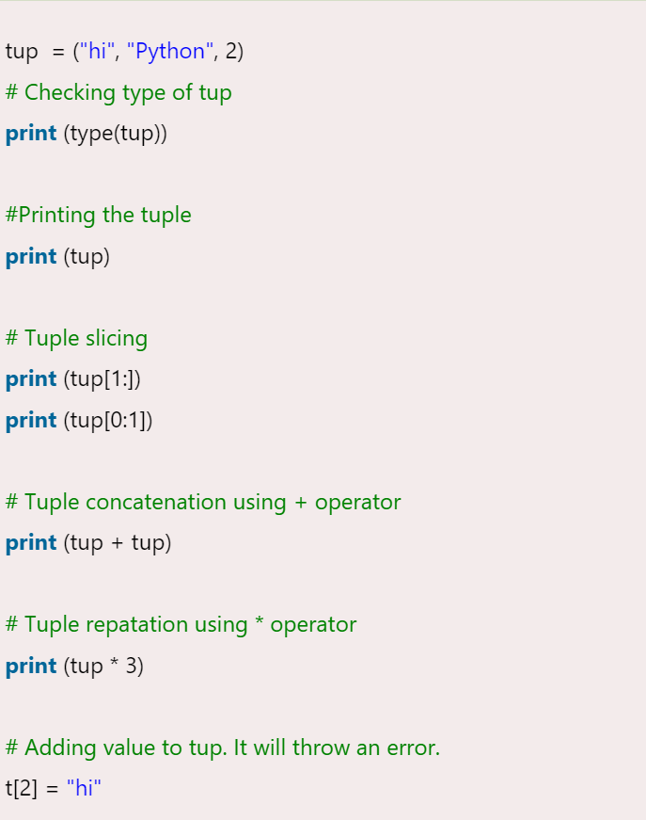
TRY these examples

Slide 44
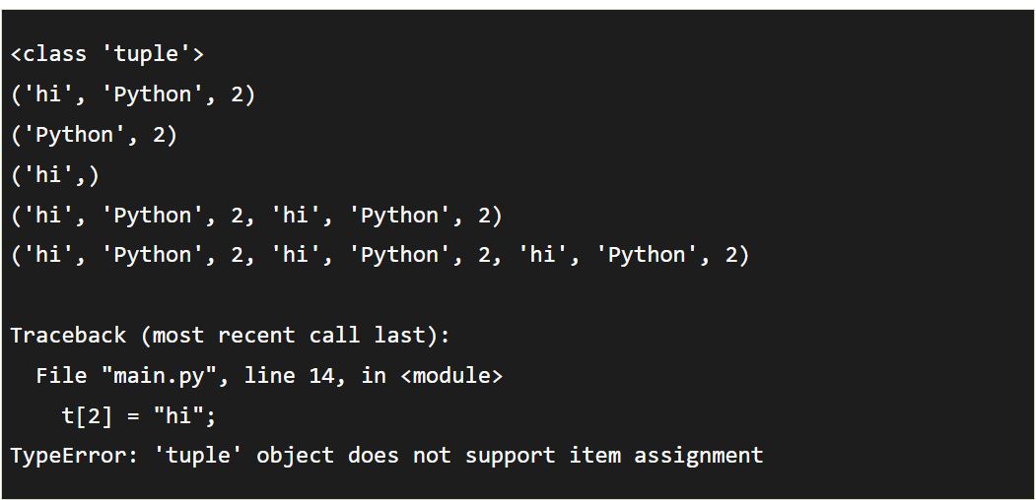
output

Slide 45
Dictionary
Dictionary is an unordered set of a key-value pair of items. It is like an associative array or a hash table where each key stores a specific value. Key can hold any primitive data type, whereas value is an arbitrary Python object.
The items in the dictionary are separated with the comma (,) and enclosed in the curly braces {}.
Indexing starts with 1

Slide 46
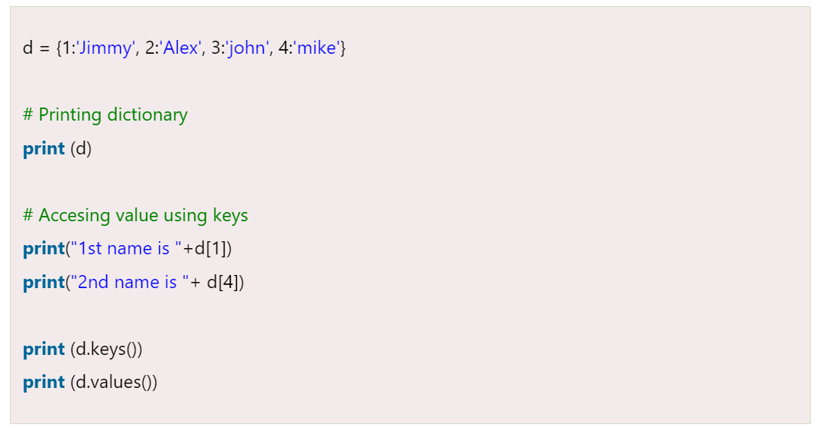
Try these examples

Slide 47
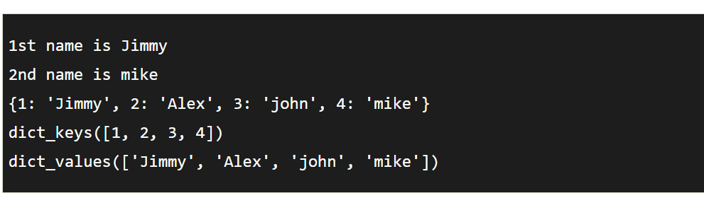
Output

Slide 48
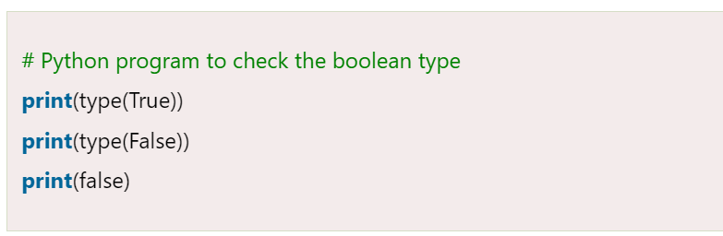
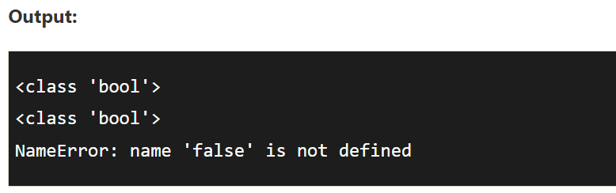
Boolean
Boolean type provides two built-in values, True and False. These values are used to determine the given statement true or false. It denotes by the class bool. True can be represented by any non-zero value or 'T' whereas false can be represented by the 0 or 'F'. Consider the following example.

Slide 49
Set
Python Set is the unordered collection of the data type. It is iterable, mutable(can modify after creation), and has unique elements. In set, the order of the elements is undefined; it may return the changed sequence of the element. The set is created by using a built-in function set(), or a sequence of elements is passed in the curly braces and separated by the comma. It can contain various types of values. Consider the following example.

Slide 50
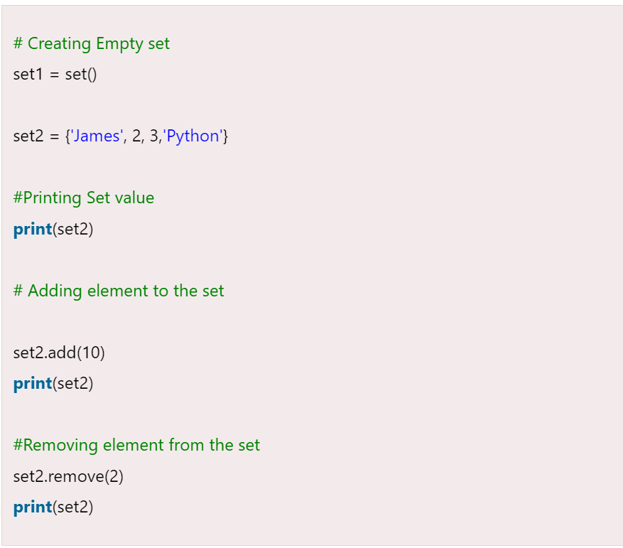
Try these example

Slide 51
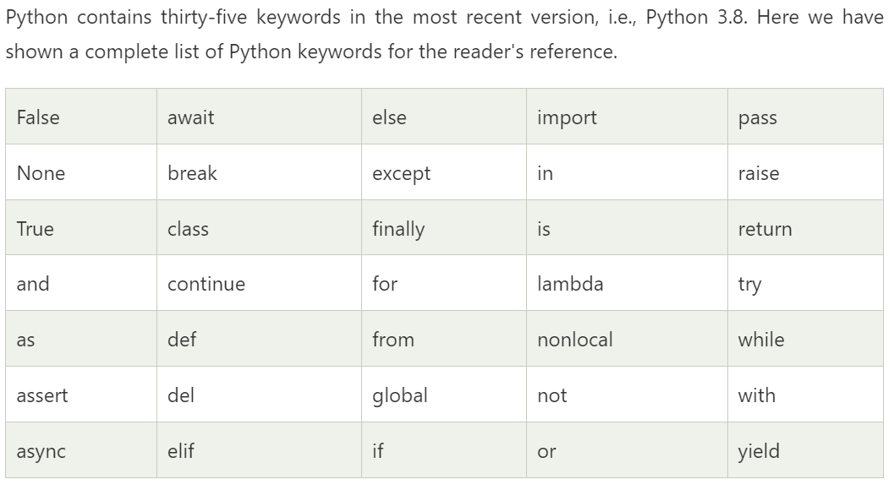
PYTHON KEYWORDS

Slide 52
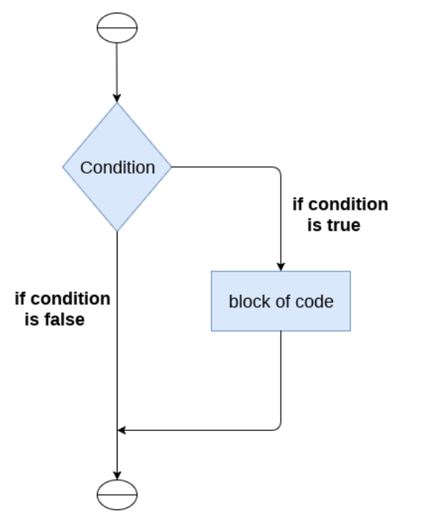
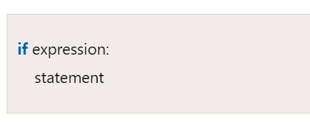
Conditional Statement The if statement
The if statement is used to test a particular condition and if the condition is true, it executes a block of code known as if-block. The condition of if statement can be any valid logical expression which can be either evaluated to true or false.

Slide 53
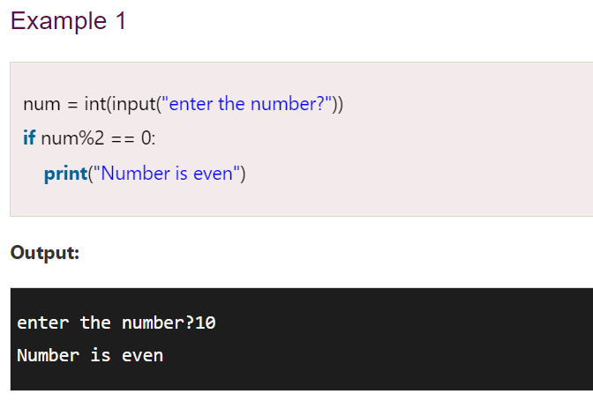
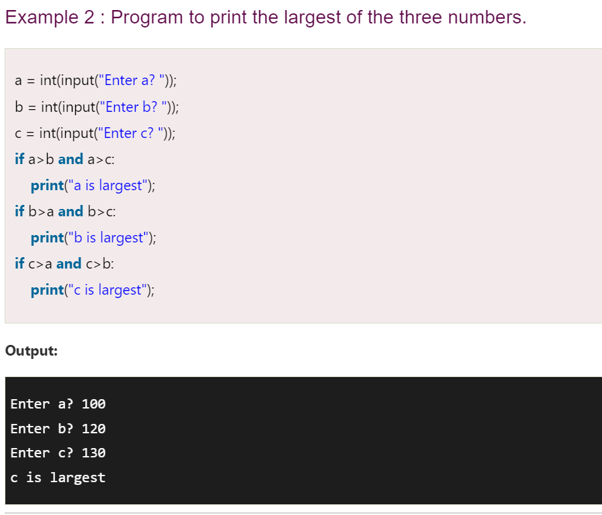
Try

Slide 54
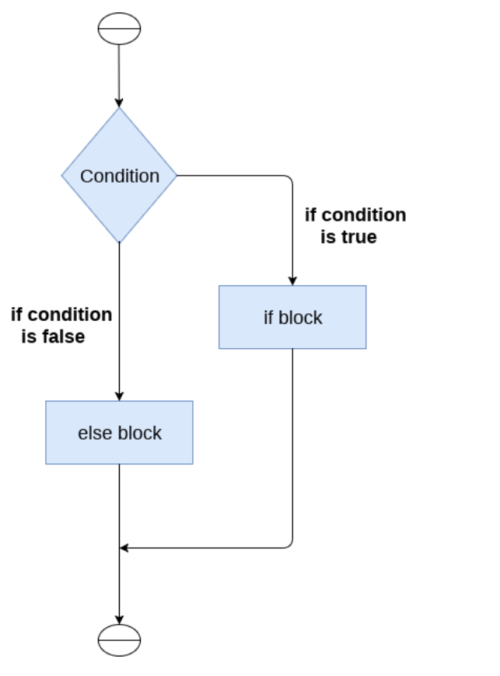
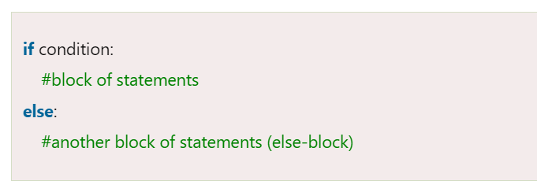
The if-else statement
The if-else statement provides an else block combined with the if statement which is executed in the false case of the condition.If the condition is true, then the if-block is executed. Otherwise, the else-block is executed.

Slide 55
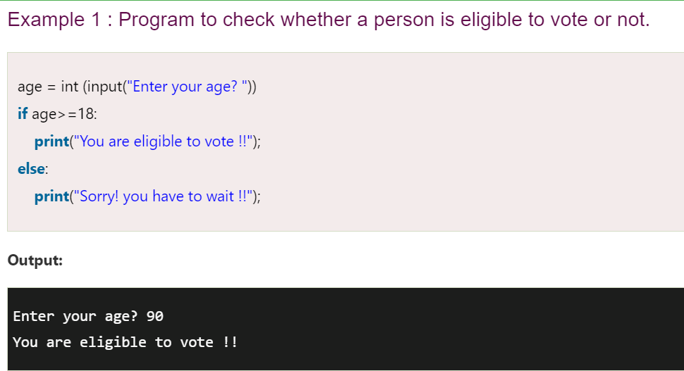
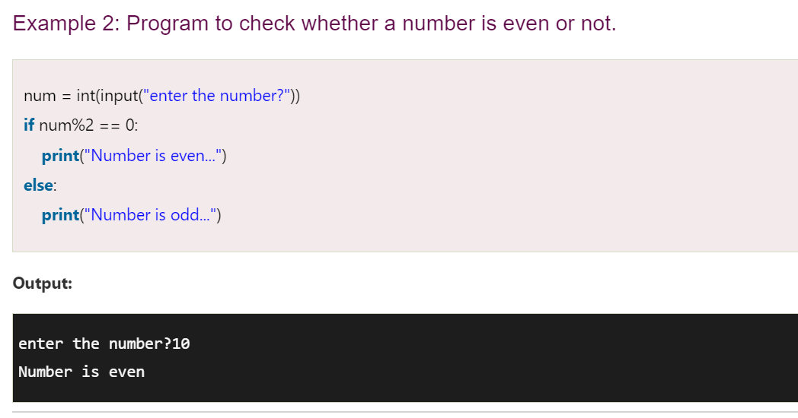
Try these

Slide 56
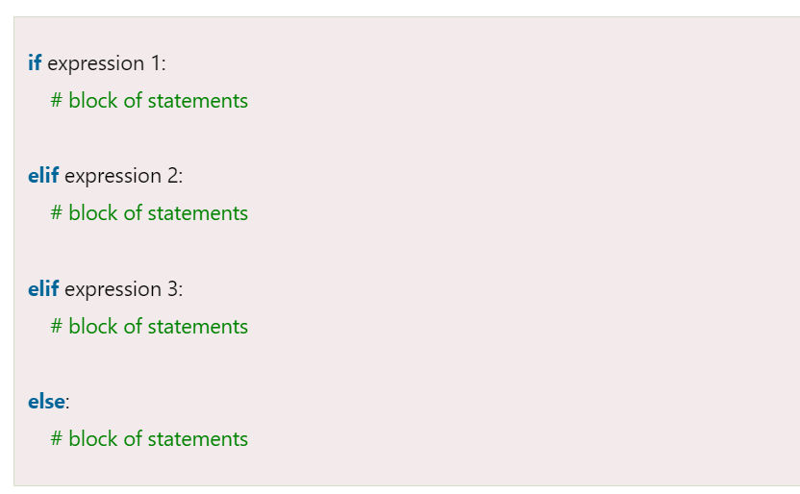

The elif statement
The elif statement enables us to check multiple conditions and execute the specific block of statements depending upon the true condition among them.

Slide 57

Try these

Slide 58
TRY THIS
TRY to print grade of a student if
80-85 Grade C
85-95 Grade B
Above 95 Grade A
Else Fail

Slide 59


Slide 60
TRY to find whether no is Prime or not
Try to print the list in reverse order
TRY to calculate the sum of digits of a number
Try to print minimum digit in a number

Slide 61

Python loops

Slide 62


FOR LOOP

Slide 63

Try this example

Slide 64


While loop

Slide 65

Try this

Slide 66

Loop Control Statements

Slide 67

Continue It returns the control to the beginning of the loop.

Slide 68

Break Statement It stops the execution of the loop when the break statement is reached.

Slide 69


Pass Statement Pass statements are used to create empty loops. Pass statement is also employed for classes, functions, and empty control statements.

Slide 70


Python function By including functions, we can prevent repeating the same code block repeatedly in a program.

Slide 71


Another example

Slide 72
Function arguments
Default arguments
Keyword arguments
Required arguments
Variable-length arguments
*args -These are Non-Keyword Arguments
**kwargs -These are Keyword Arguments

Slide 73
Default arguments
def my_function(fname=“Emilly”, lname=“Thomas”): print(“fname”,fname)
print(“lname”,lname) my_function()

Slide 74
Required Arguments
def my_function(fname, lname): print(“fname”,fname)
print(“lname”,lname) my_function("Emilly", “thomas")

Slide 75
Arbitrary Arguments, *args
def my_function(*kids): print("The youngest child is " + kids[2]) my_function("Emil", "Tobias", "Linus")

Slide 76
Keyword Arguments
def my_function(child3, child2, child1): print("The youngest child is " + child3) my_function(child1 = "Emilly", child2 = "Tobias", child3 = "Linus")
OR
def my_function(**kid): print("His last name is " + kid["lname"]) my_function(fname = "Tobias", lname = "Refsnes")

Slide 77
Lambda function
lambda [argument1 [,argument2... .argumentn]] : expression
# Python code to demonstrate ananymous functions
# Defining a function
lambda_ = lambda argument1, argument2: argument1 + argument2;
# Calling the function and passing values
print( "Value of the function is : ", lambda_( 20, 30 ) )
print( "Value of the function is : ", lambda_( 40, 50 ) )

Slide 78
Try
TRY to print grade of a student if
80-85 Grade C
85-95 Grade B
Above 95 Grade A
Else Fail
(Using a user defined Function)

Slide 79
Python file handling
In Python, files are treated in two modes as text or binary. The file may be in the text or binary format, and each line of a file is ended with the special character.
Hence, a file operation can be done in the following order.
Open a file
Read or write - Performing operation
Close the file

Slide 80
Open & closing a file
Syntax:
File_object = open(<file-name>, <access-mode>, <buffering>)
Syntax
fileobject.close()
#opens the file file.txt in read mode
fileptr = open("file.txt","r")
if fileptr:
print("file is opened successfully")
try:
fileptr = open("file.txt")
# perform file operations
finally:
fileptr.close()

Slide 81

Access mode

Slide 82
Writing in a file
# open the file.txt in append mode. Create a new file if no such file exists.
fileptr = open("file2.txt", "w")
# appending the content to the file
fileptr.write('''''Python is easy language. It is simple.
It is the fastest-growing programing language''')
# closing the opened the file
fileptr.close()

Slide 83
Exceptions
Try and Except Statement - Catching Exceptions
In Python, we catch exceptions and handle them using try and except code blocks. The try clause contains the code that can raise an exception, while the except clause contains the code lines that handle the exception. Let's see if we can access the index from the array, which is more than the array's length, and handle the resulting exception.
# Python code to catch an exception and handle it using try and except code blocks
a = ["Python", "Exceptions", "try and except"]
try:
#looping through the elements of the array a, choosing a range that goes beyond the length of the array
for i in range( 4 ):
print( "The index and element from the array is", i, a[i] )
#if an error occurs in the try block, then except block will be executedby the Python interpreter
except:
print ("Index out of range")

Slide 84
Syntax
try:
# Code block
# These statements are those which can probably have some error
except:
# This block is optional.
# If the try block encounters an exception, this block will handle it.
else:
# If there is no exception, this code block will be executed by the Python interpreter
finally:
# Python interpreter will always execute this code.

Slide 85
Python OOPs Concepts
Major principles of object-oriented programming system are given below.
Class
Object
Method
Inheritance
Polymorphism
Data Abstraction
Encapsulation

Slide 86

Class The class can be defined as a collection of objects. It is a logical entity that has some specific attributes and methods.

Slide 87

Object The object is an entity that has state and behavior. It may be any real-world object like the mouse, keyboard, chair, table, pen, etc. Everything in Python is an object, and almost everything has attributes and methods.

Slide 88

INHERITENCE

Slide 89

example

Slide 90

M- Inheritence

Slide 91

Example

Slide 92
Polymorphism
x = "Hello World!" print(len(x))
mytuple = ("apple", "banana", "cherry") print(len(mytuple))
thisdict = { "brand": "Ford", "model": "Mustang", "year": 1964 } print(len(thisdict))

